Slide 1
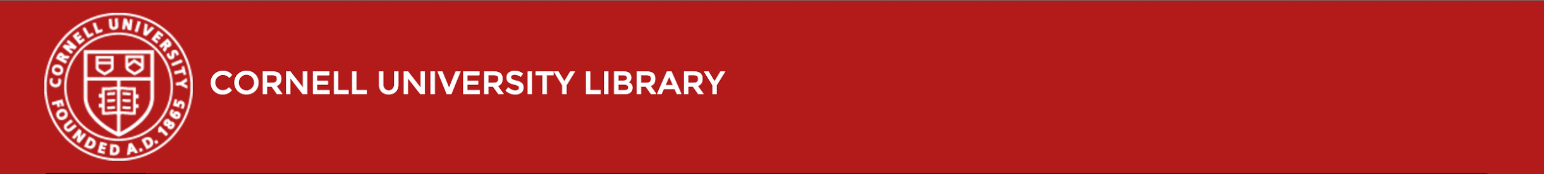
Building a user-friendly authorities browse in Blacklight
Jenn Colt, User Experience Developer @starsplatter
Frances Webb, Developer @fbw4
code{4}lib 2016
Notes:
One of the requirements of our move to Blacklight for the public interface of our catalog was that we find a way to provide a headings search and browse that would adequately replace those features in voyager.
As part of that process, we wanted to make sure the headings interface would be an understandable and integrated part of the catalog interface.

Slide 2
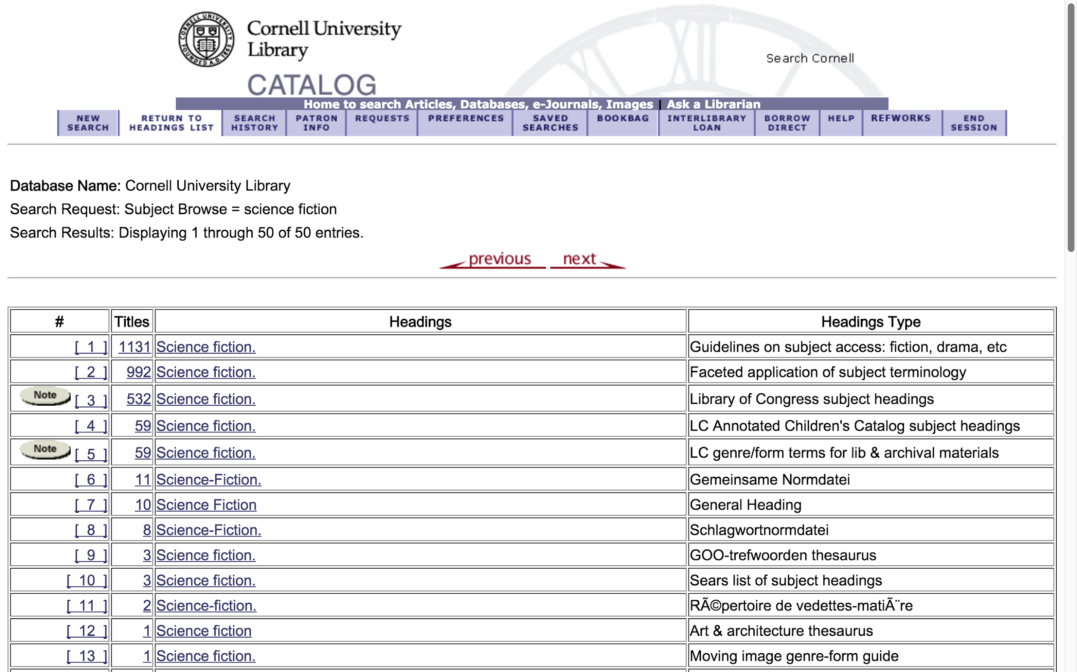
Notes:
First, here’s a subject browse in Voyager, just to give you an idea of where we starting from. You’ll note here that there are a lot of entries for the subject “science fiction”. The headings in the voyager catalog are organized by vocabulary.

Slide 3
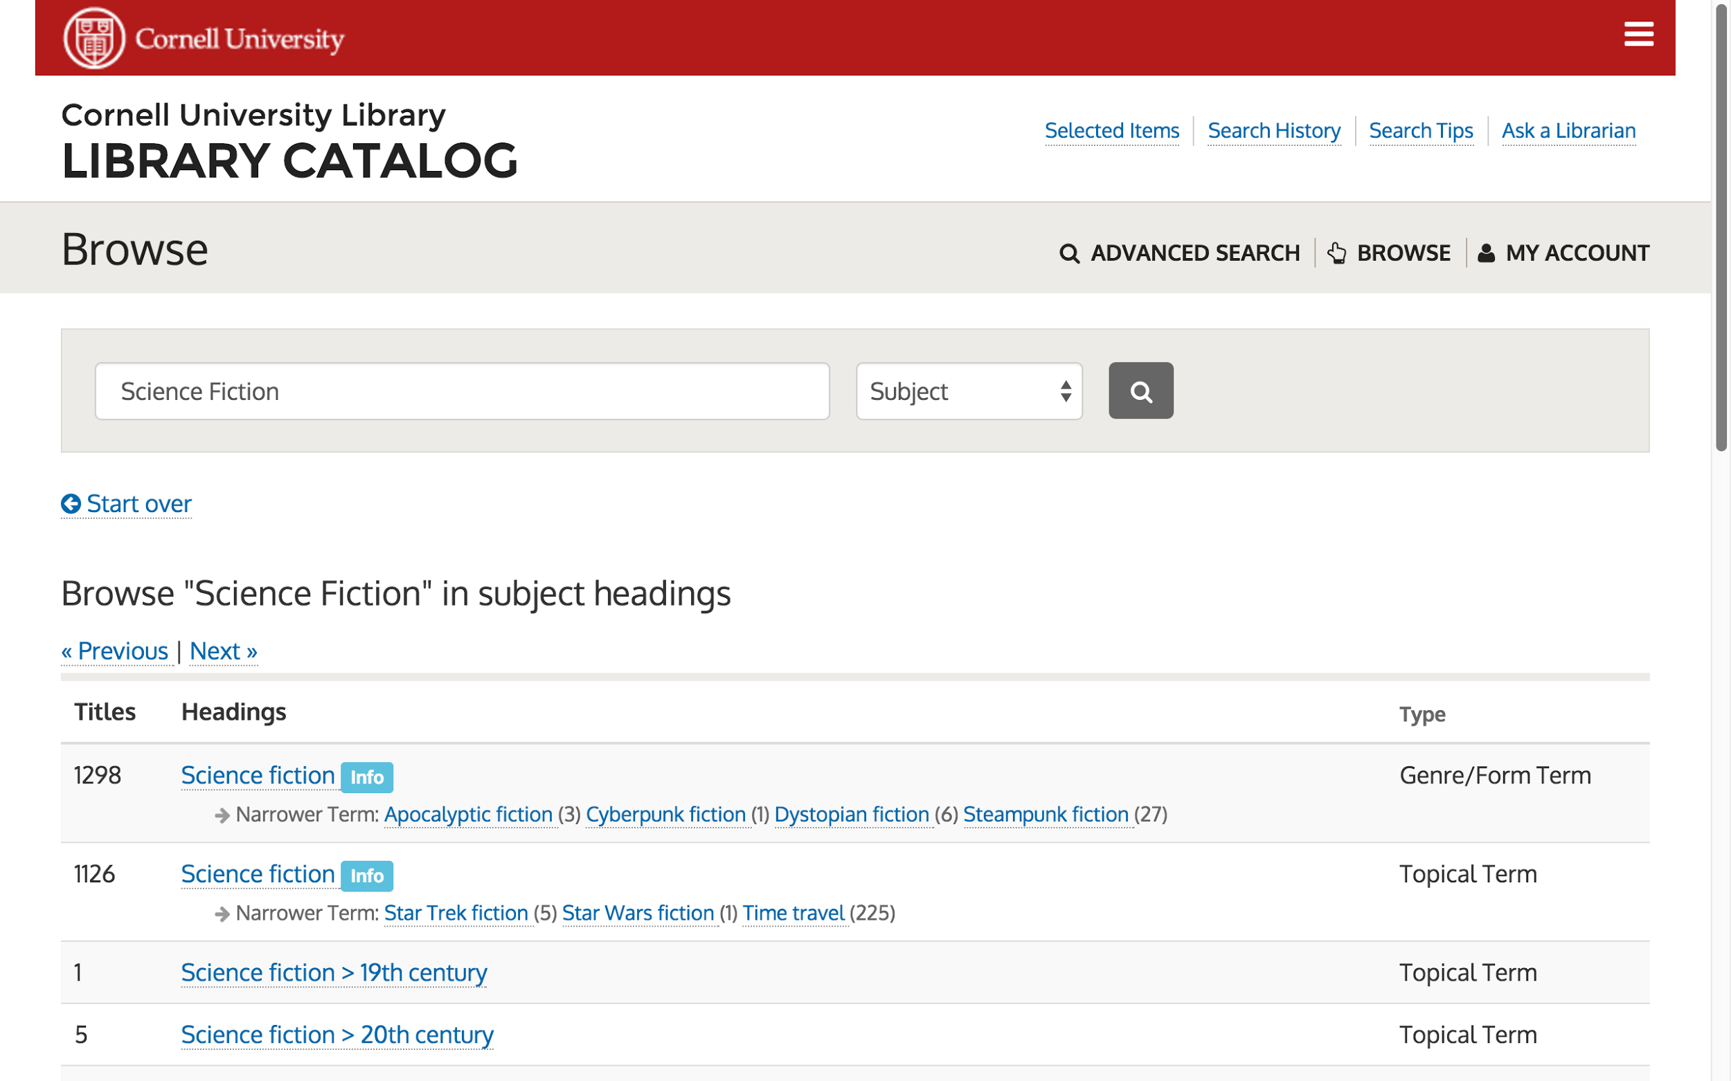
Notes:
In blacklight you can see we’ve made a big change, where the headings are now listed by what field the subject heading is in. There are still multiple listings for science fiction, but it’s a little easier to understand what is going on.
In addition, we chose, when the list was of a reasonable length, to include see also’s in the browse.

Slide 4
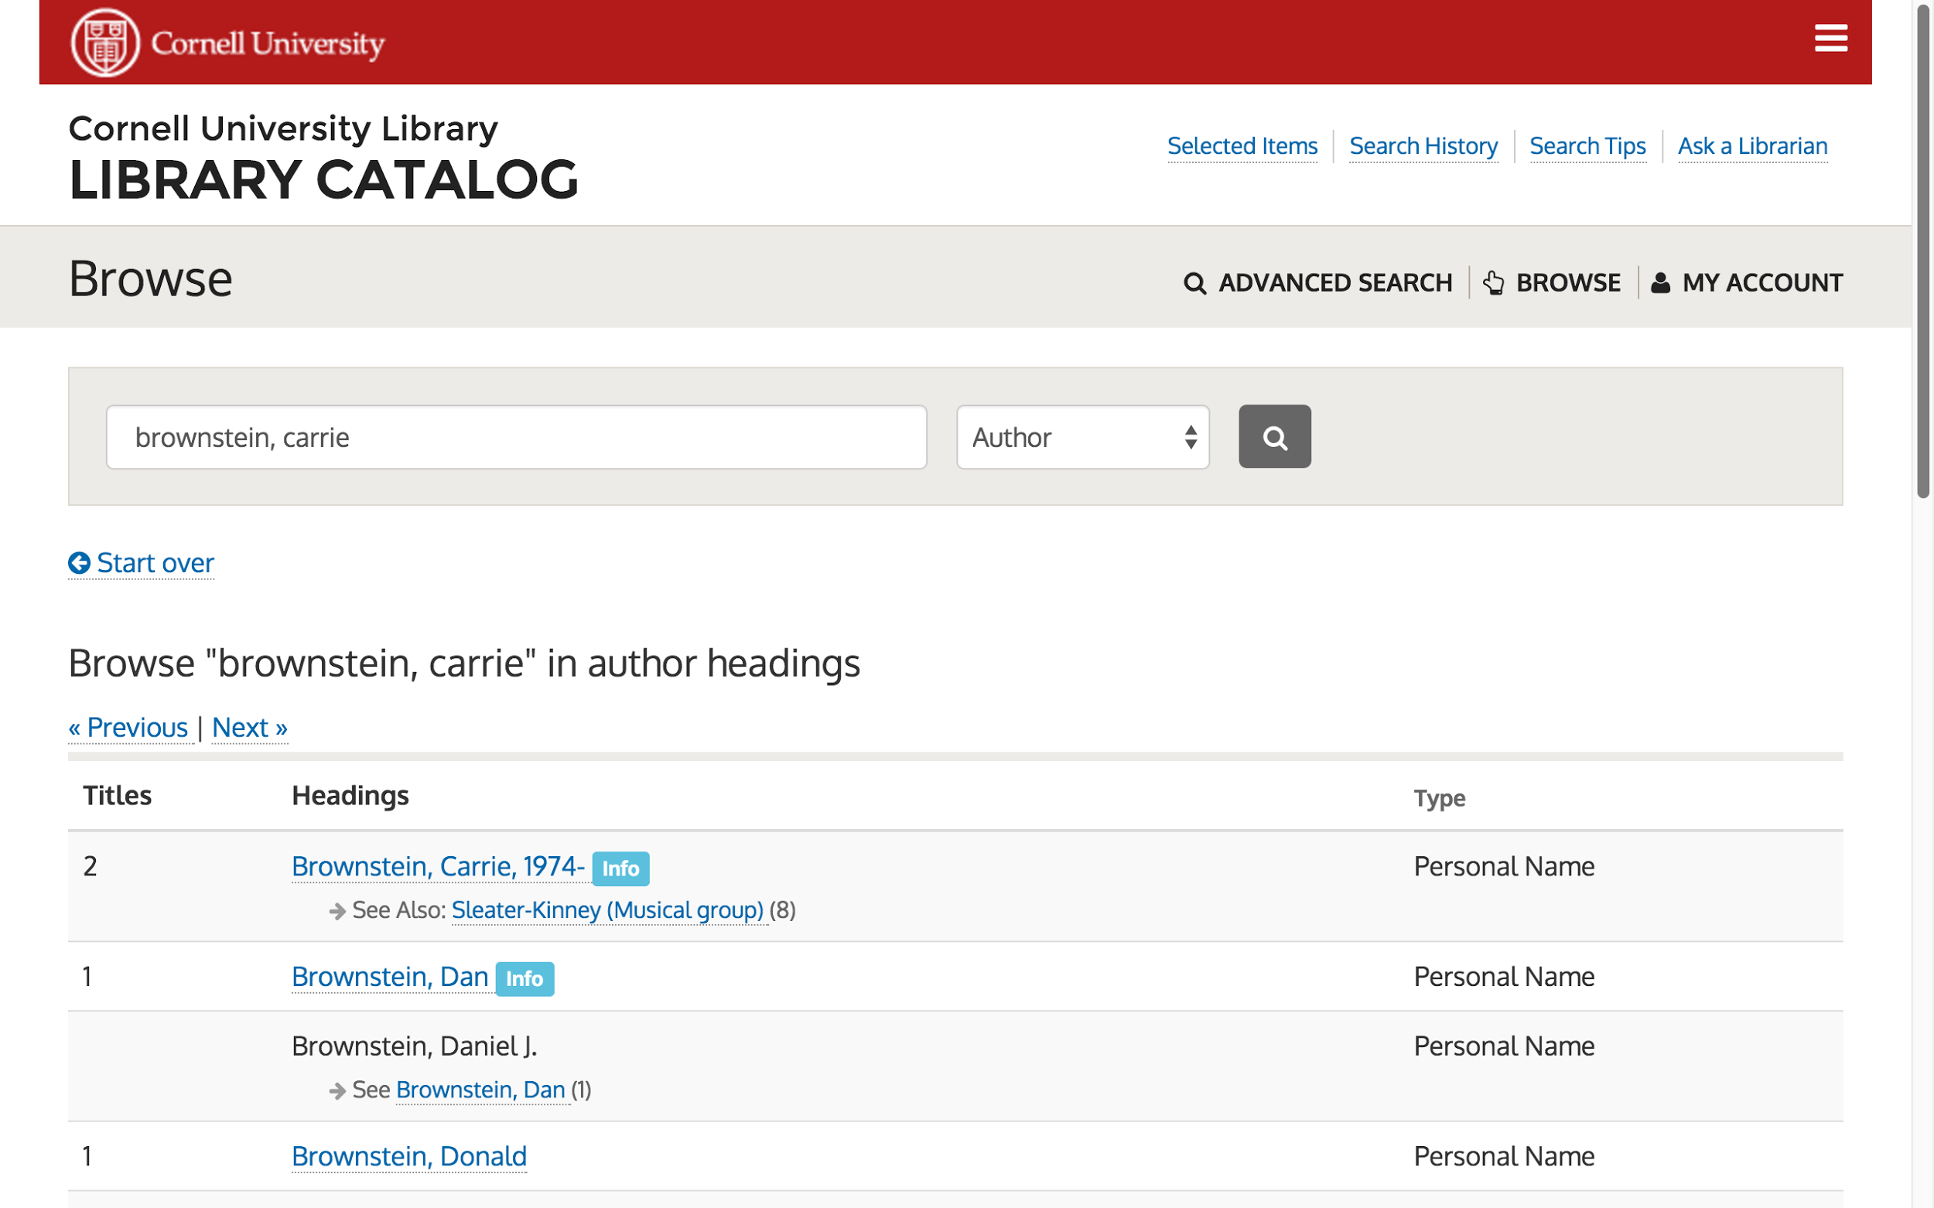
Notes:
The author headings also provide convenient see also links when they’re appropriate.

Slide 5
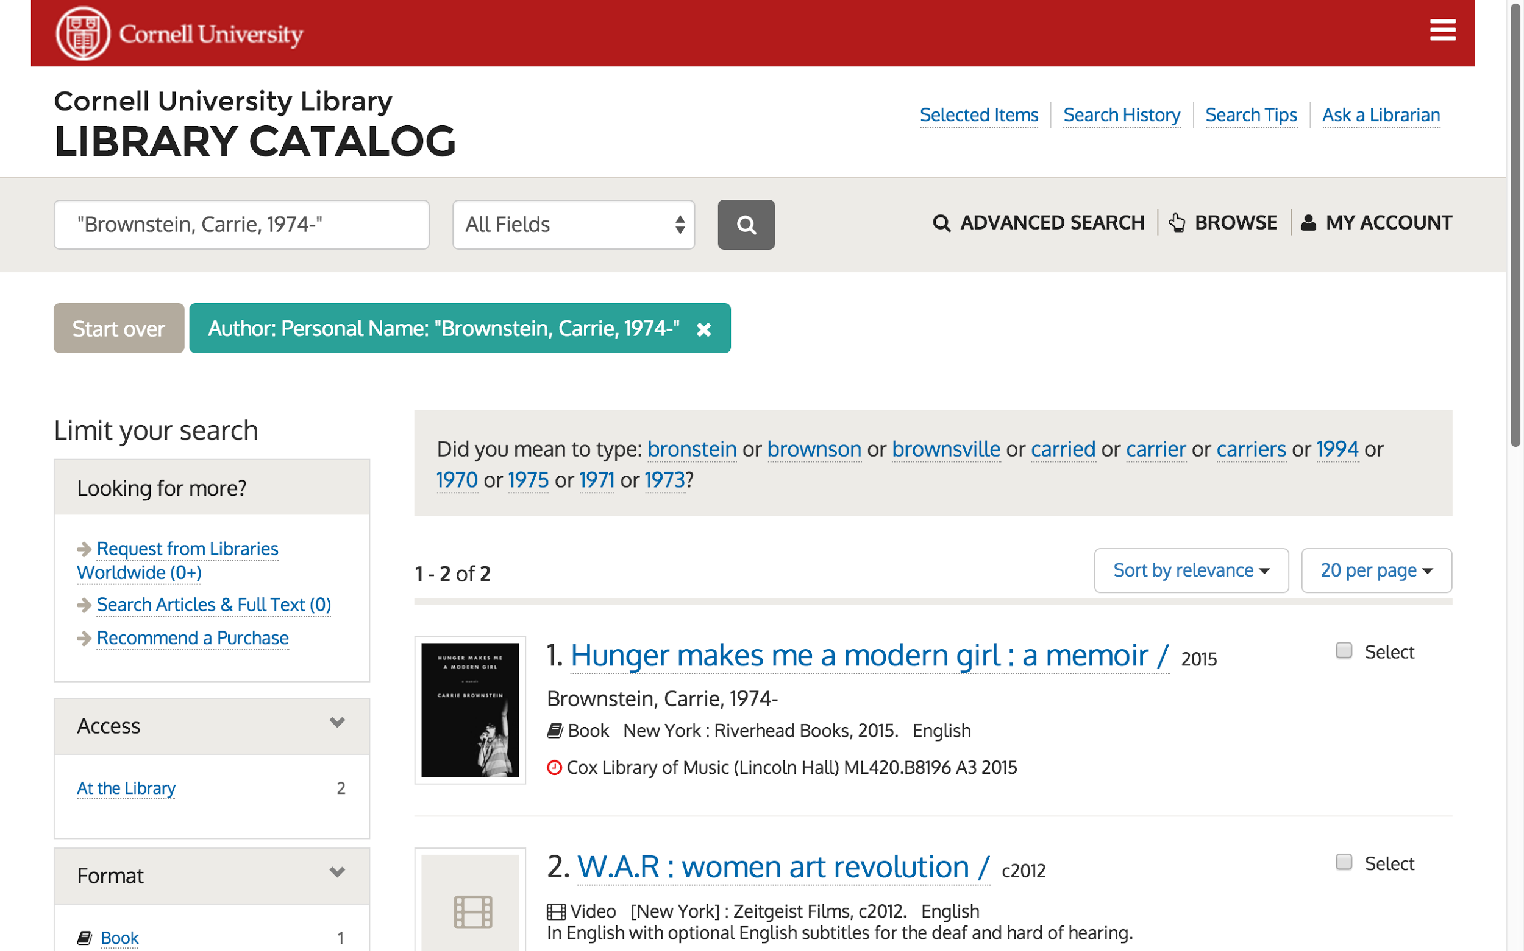
Notes:
To integrate these browses with the catalog, we’ve created search links on the headings that lead the user back to catalog results. All of the headings either have a link to search results for that heading or a link to a see or see also link that will provide search results. We aren’t including headings in the browse unless they have some type of search result associated with them.

Slide 6
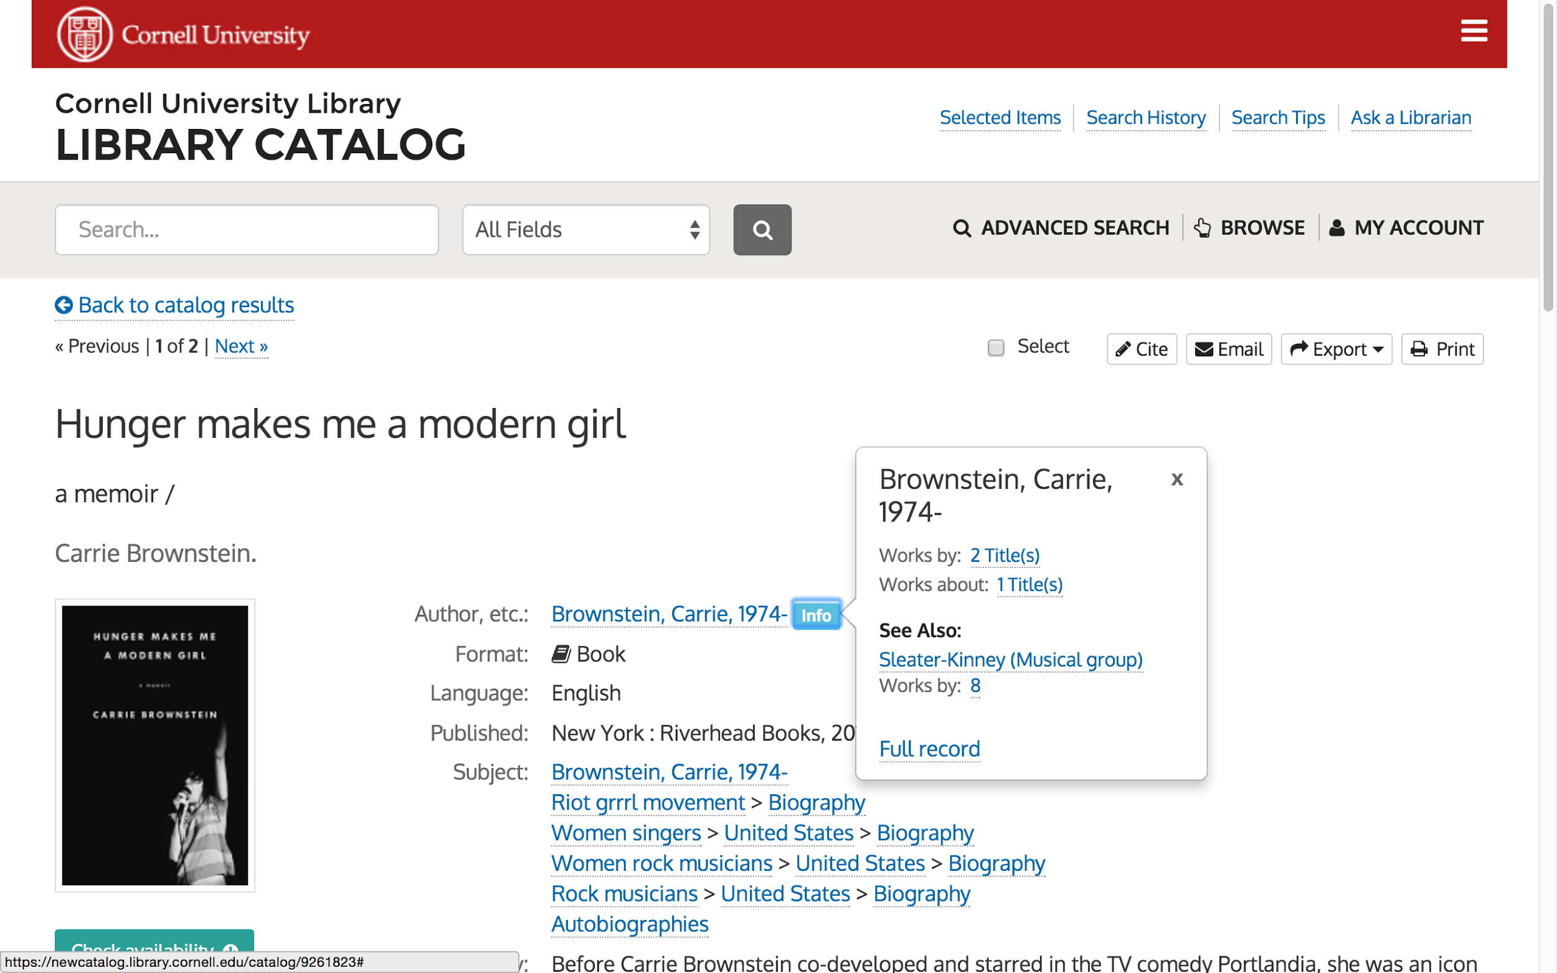
Notes:
We’ve also integrated the headings into the item views on the catalog, where when an authorized author heading appears, the user can click an info button for more information about the author as well as search links both for the given heading and its see also’s.

Slide 7
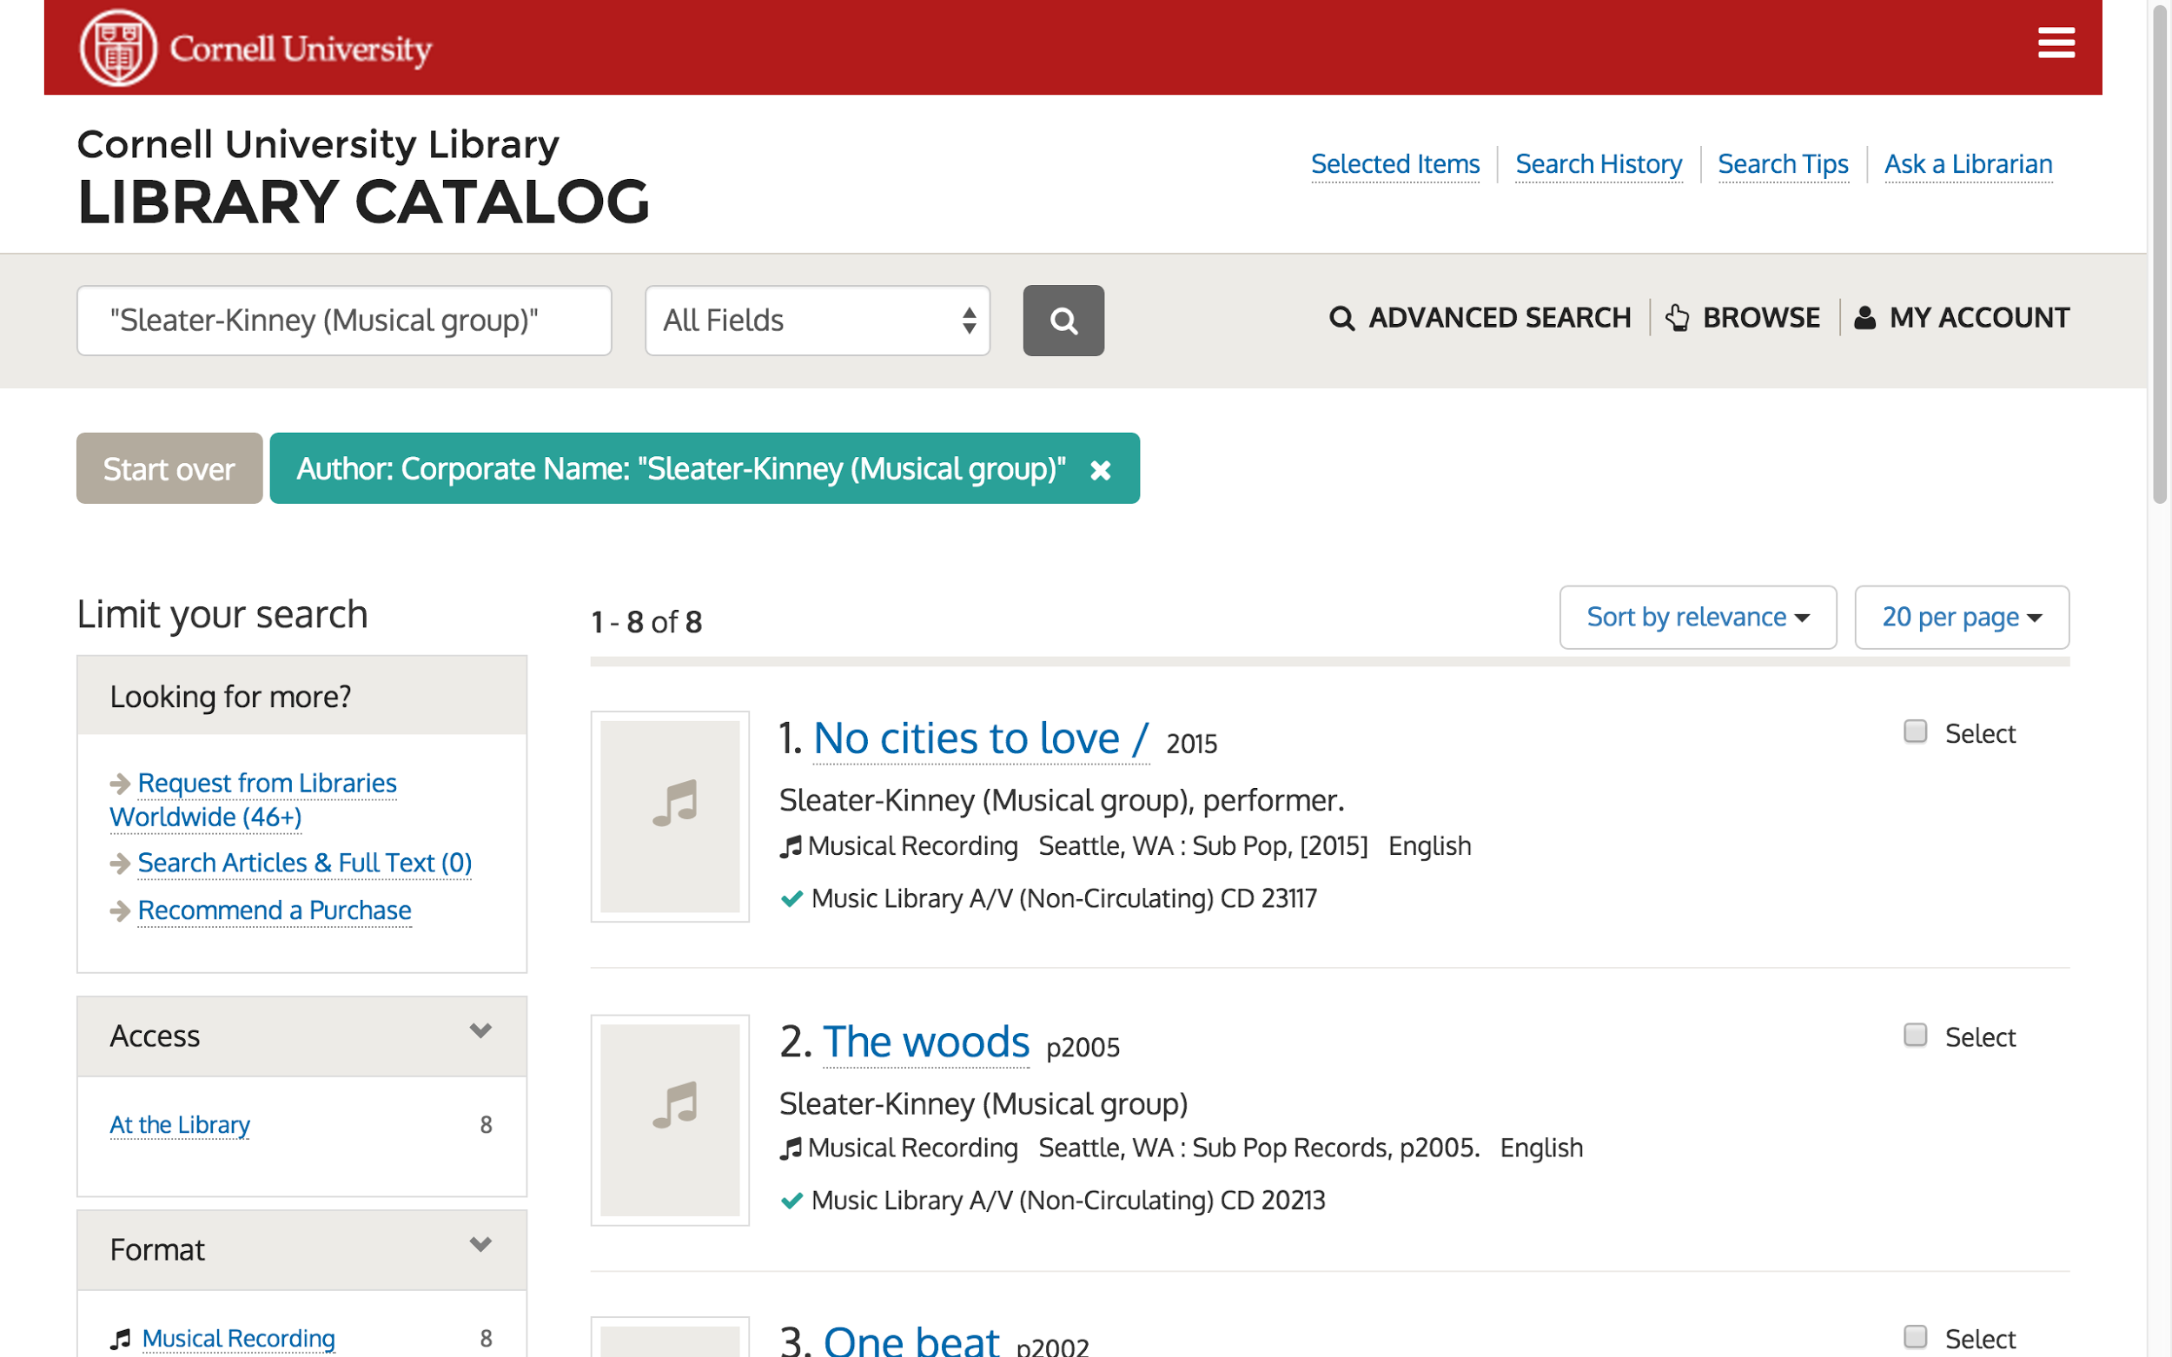
Notes:
Search results are provided again when the user clicks on the link for the works of a related heading in that info box.

Slide 8
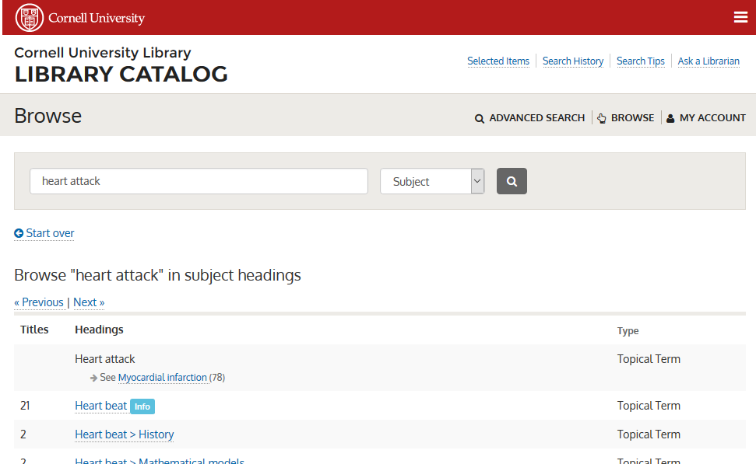
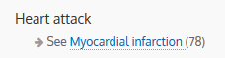
Notes:
Cross references in this browse interface come in a few categories, but I want to talk a minute about the "see" references. With the "see" reference we are saying to patrons, "we think you might be looking in the wrong place." This can be vital information to expose, as the preferred term may not be something a patron would ever think to search for.

Slide 9
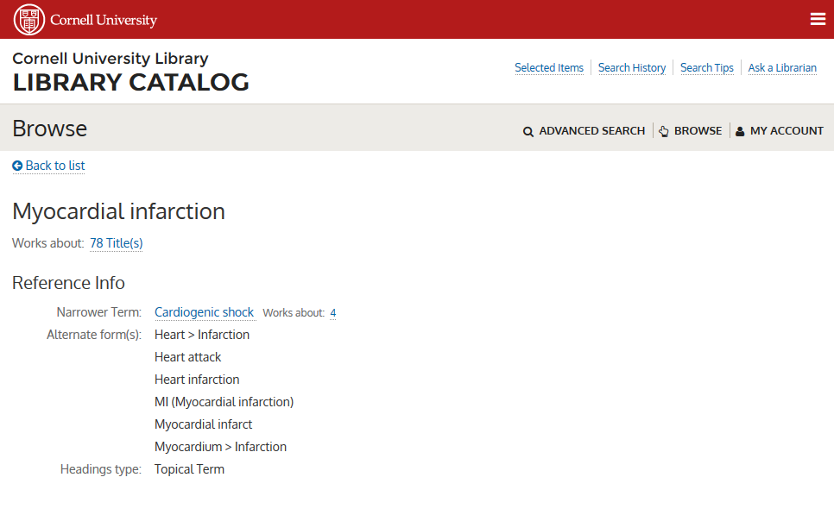
Notes:
The information derives from the authority records, and their alternate form entries. (The primary purpose of the information is to help lead catalogers to the preferred headings, but what catalogers might need help connecting, so might anyone else.) These cross references can help a patron to figure out what they ought to be searching for, but will only work if patrons understand that checking the browse might help them to clarify their searching. If they naively attempt to search the wrong term in the catalog, they would get neither the results they hope for, nor the information that they might improve their results.
As of 2015, a patron making a subject search for heart attack in the Cornell Library catalog would find zero results. They might look deeper, or they might conclude that we just don't have what they want. Starting at the beginning of the 2016 calendar year, our catalog records that use authorized forms of author, contributor, or subject heading metadata are now discoverable in the general search using the alternate forms of the headings. It's always better when we can provide the expected behavior, even if the expectations are naive, than to have to attempt to train patrons to understand our limitations.

Slide 10
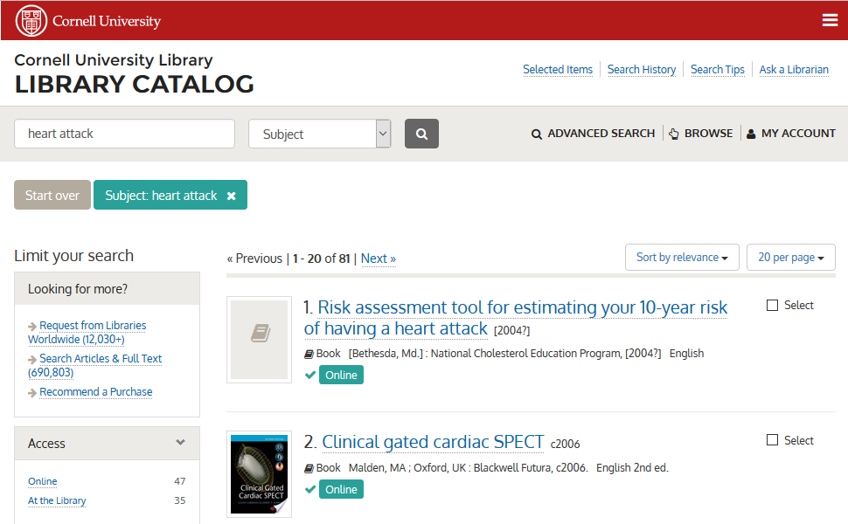
Notes:
Only a few months ago, this response would have said, “Your search returned 0 results, “ so this is much more satisfying. None of the results from this search include the subject term "heart attack".

Slide 11
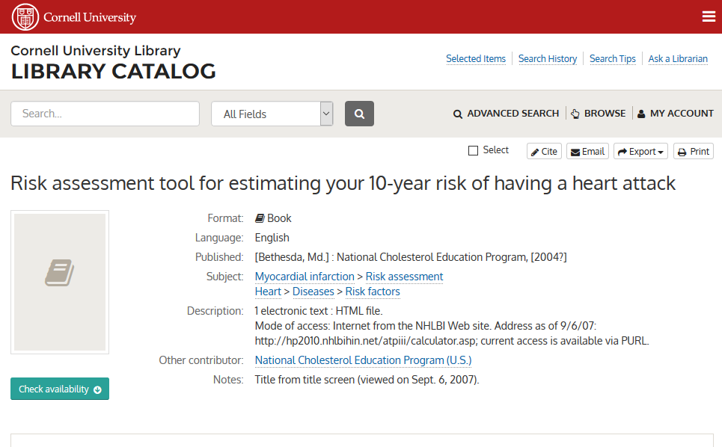
Notes:
This work includes "heart attack" in the title, so would already have been found in a general all-fields search, but not in a subject search.

Slide 12
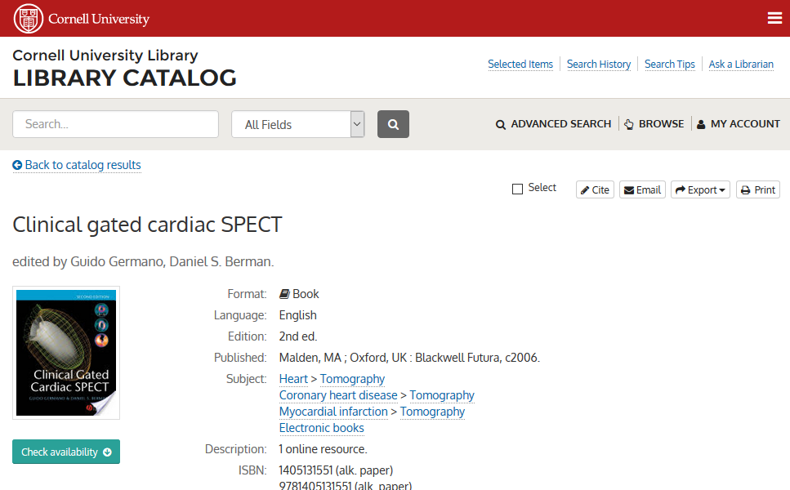
Notes:
This record doesn't contain the word "attack" in any form or location, yet it's clearly an appropriate result.
This is a subtle change to our catalog indexing, where we hope that patrons will find the things they are looking for without realizing that we've done anything interesting to facilitate it. Though this hasn't been live in the Cornell catalog for very long, things are going well with it so far. This piece is potentially implementable separately from a full browse, as long as whatever code is indexing works for an OPAC can be made to perform the authorities query to retrieve alternate forms.

Slide 13
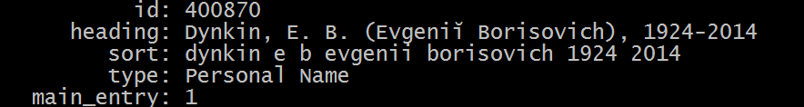
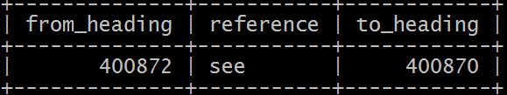
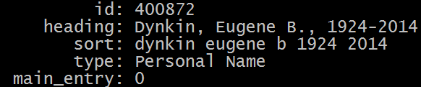
Indexing Details - Step one, indexing authority
Notes:
Indexing the authority file is something that has been accomplished any number of times, and is the first step in our processing for generating the browse data we're using. When indexing authority records into a database, we assign our own identifiers to each heading, because the authority file natively assigns identifiers only to the authority record itself, and not to each of the cross references. In order to make a map of all the various kinds of cross references, all of the alternate forms require their own ID's.
(Anyone who is doing their own indexing of the authority records should ask a cataloger to explain undifferentiated personal name records. Beware the undifferentiated name records.)

Slide 14
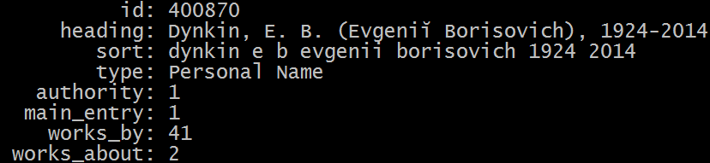
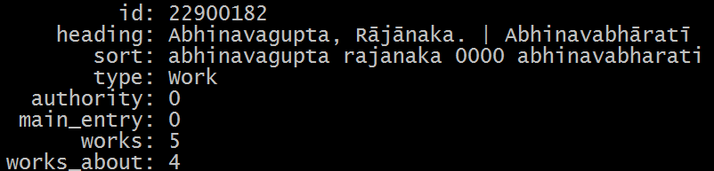
Indexing Details - Step two, indexing bib headings
Notes:
Once we have a database index of the entire name authority file and library of congress subject heading file, the next step is to overlay actual catalog heading data. This means making a series of twelve terms queries to our Blacklight Solr index of bibliographic records, and tabulating what headings appear in our bibs, in what fields, and it what numbers. These numbers are added to the information we have for authority headers, and new headers records are added to our database for headings we did not see in the authority file.

Slide 15


Indexing Details - Step three, populating Solr
MySQL Headings DB
Solr
Browse Indexes
Contains
28 million total headings
10.3 million authorized headings
7.7 million unauthorized headings that appear as authority x-refs
10.4 million unauthorized headings that do not appear in authority at all
Contain
13.4 million total headings
2.8 million authorized headings
2.8 million unauthorized headings that appear as authority x-refs
10.4 million unauthorized headings that do not appear in authority at all
Notes:
Finally, we push the data from the database into browse Solr indexes. We only push headings that have associated content in our catalog, cross-references that lead patrons toward headings that have associated content, and headings that have no associated content but do have cross references pointing from them to headings that have associated content.
(I've been asked why it was a good idea to go to all of this effort to build a new Solr index model for browse, rather than using Solr's native ability to tabulate records to provide the summary out of the same index we use for our general OPAC searching. The answer is that despite the fact that Solr provides a variety of summarization tools, including facet queries, terms queries and result grouping, Solr is strongest when the granularity of the things you want to see matches the granularity of the Solr document. In our general OPAC index, each Solr document maps to a bibliographic record. Here, a Solr document represent a unique heading. Building an index that is about headings rather than documents gives us a level of control to integrate multiple data sources, describe the headings more richly, and to fine tune sort order. The current browse includes multiple sources of data already, and we hope to include more outside sources in the future.)

Slide 16
Sort vs Filing
or Birds of a Feather, File together
Beethoven, Ludwig van, 1770-1827 | beethoven ludwig van 1770 1827
Beethoven Ludwig van, 1770-1827 | beethoven ludwig van 1770 1827
Beethoven, Ludwig van, 17709-1827 | beethoven ludwig van 17709 1827
Beethoven, Ludwig Van, 1770-1827 | beethoven ludwig van 1770 1827
Beethoven, Ludwig van | beethoven ludwig van
Notes:
The concept of normalizing values for sort is not new. Systems that sort strings without normalization are often immediately obvious because they alphabetize all of the capital letters before the lower case letters, and allow punctuation and diacritics to confuse the sort order. The normalization that we use for this project is importantly a filing normalization, in addition to a sort normalization. This means that if two headings normalize to the same value, then we deem them to be the same heading. While a human being might be able to guess that all of these values do represent the same individual, the filing normalization is not designed to make inferences, so merging the outliers is a separate task.

Slide 17
Sort vs Filing
or Birds of a Feather, File together
Stuart, Tyson | stuart tyson
Stuart & Tyson | stuart tyson 7&
Notes:
Because we are using the same normalization for sort and filing, it's vital to be clear about the distinction between the two. We would not expect these two headings to sort to different sections of an alphabetic list, but we would also not expect them to be merged. By moving the ampersand to the end with a notation of the character offset it was moved from, we can ensure that these will sort adjacently, while remaining separate.

Slide 18
Sort vs Filing
or Birds of a Feather, File together
Dutch East Indies | dutch east indies
Dutch > East Indies | dutch 0000 east indies
Notes:
These two headings are also important to distinguish, as the Dutch East Indies is not the same as the Dutch people in relation to the East Indies. This is not a facetious example... these are both real headings in our catalog. In this case, the normalization fills the filing goal by producing distinct normalized values, but the sort goal is different because we want the distinction to be reflected in sort behavior. In this case, we want the second heading to sort with the other headings relating to main subject, "Dutch". The zeros force the sort order to produce a sort pivot at the divider, sorting first by the main subject, then by the subdivision.

Slide 19
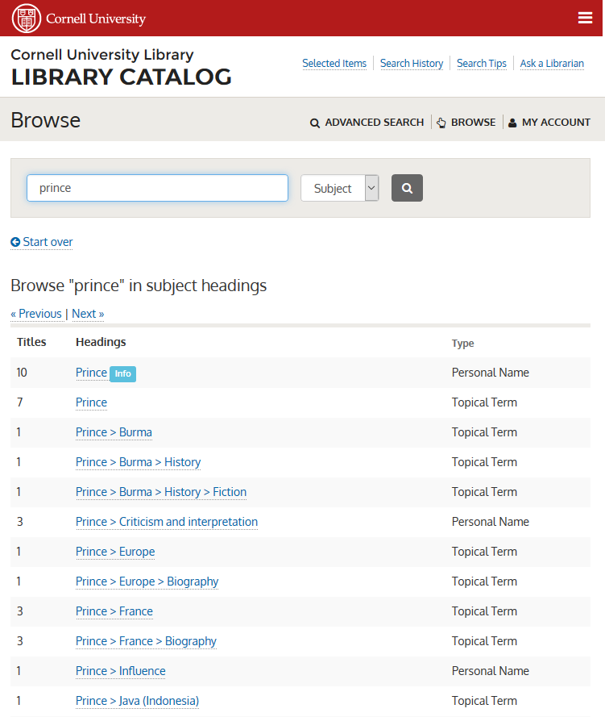
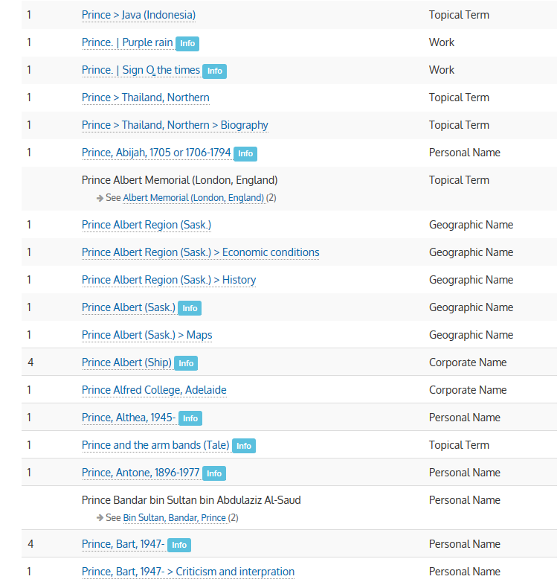
Notes:
Here's a more concrete example of what this means. In our subject browse, all of the headings that are subdivision under "Prince" appear directly under the heading "Prince", and before unrelated subject terms that start with "Prince". You can see at the top of the second column that works use the same sort pivot with the pipe character. You can see that the concept of a Prince as royalty and the individual, Prince, are still intermingled, but without the pivot grouping them, we couldn’t hope to find them all in browse.

Slide 20
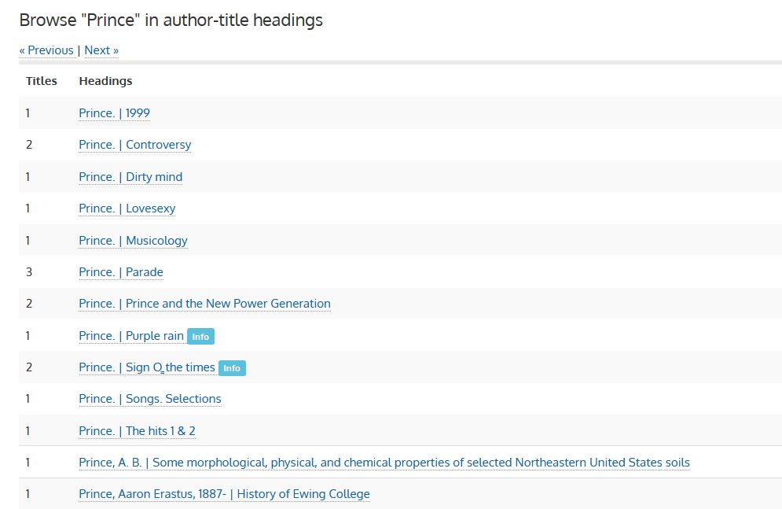
Notes:
This is also vital for the works of Prince that you might find in the author-title browse. The vertical pipe causes a sort pivot, grouping the works by author before sorting by title.

Slide 21
Code References
Github: https://github.com/cul-it
Front-End:
controller
views
Indexing:
step 1: authorities to MySQL
step 2: blacklight headings to MySQL
step 3: MySQL to Solr
filing normalization code (and related Solr plugin for Solr 4.2)

